Slide 1
Stewardship
Jason Fisher
Jason@veritascolumbus.com – consideringstewardship.com/veritas

Slide 2
Who am I?
My name is Jason Fisher
Deacon of stewardship at Veritas.
I have written for years on personal finance; I occasionally write at consideringstewardship.com
Standard Disclaimer
I am NOT an attorney.
I am NOT an accountant.
I am NOT a certified financial advisor or counselor.
Everyone should do their own due diligence and determine what is best for their specific situation.

Slide 3
What is Biblical Stewardship
The core idea of stewardship is that God, as sovereign creator, is the owner of everything (Gen. 1:1, Psalm 24:1).
As a result, we can’t claim ultimate rule or ownership over anything. 1 Pet 4:10
Rather, we are simply managing what the Lord has entrusted to us for a limited amount of time.

Slide 4
What is Biblical Stewardship
The earth is the Lord's and the fullness thereof, the world and those who dwell therein.
As each has received a gift, use it to serve one another, as good stewards of God's varied grace:
You shall remember the Lord your God, for it is he who gives you power to get wealth, that he may confirm his covenant that he swore to your fathers, as it is this day. For who sees anything different in you? What do you have that you did not receive? If then you received it, why do you boast as if you did not receive it?
Psalm 24:1
1 Pet 4:10
Deut 8:18
1 Cor 4:7

Slide 5
What is Biblical Stewardship
We must all understand how we idolize money to apply the Gospel to it.
As for what was sown among thorns, this is the one who hears the word, but the cares of the world and the lure of wealth choke the word, and it yields nothing.
Rich Young Ruler
John’s call to repentance
Mat 13:22
Mark 10:17
Luke 3

Slide 6
What is Biblical Stewardship
How do we apply the Gospel to how we feel about money?
How important is money to you?
Does it make you anxious to think about it?
What does the Bible do with our money as far as giving
Do you value the security that money brings?
Is your spending marked by Christian generosity?
What does your spending say about what makes you most happy?
Does your spending suggest your collecting for this life?
Is your spending explicitly supporting the spread of the gospel?

Slide 7
Different Types of Stewards
Rich Righteous Steward
Rich Unrighteous Steward
Poor
Righteous Steward
Poor Unrighteous Steward
Driscoll,Breshears “Doctrine” pp. 389-390

Slide 8
Bridging to the Practical
It is only when King Christ is given the proper value in our hearts that King Money will have neither the power nor the room to rule us. It seems that often in the churches’ money discussions we forget this, and because we do, we ask the law to do what only grace can accomplish. A budget can expose what your heart truly values, but a budget has no power to make you worship the right King. A budget can give you useful spending guidelines, but it has no power to restrain your fickle and wandering heart. A budget can make you more money aware, but it will not deliver you from temptation.
-- Paul Tripp (Sex and Money)

Slide 9
First Steps
The first step in getting anywhere is knowing where you are now.
Creating a budget brings you to an understanding of where you are currently both financially and spiritually.
Matthew 6:21 "For where your treasure is, there your heart will be also. "
Where does your money go?

Slide 10
The Budget is Your Map
How to read it properly
The initial budget may tell you different things
You are in trouble…
Debt is killing you…
You are doing fine…
You buy too much coffee…

Slide 11
The Budget is Your Map
How to Stay on the map – Sticking to your Budget
Mint.com – You have to stay on top of things to be proactive and not just reactive.
Quicken – has a budget function built in requires some customization and work to stay on top of things.
Envelope system – When the money is gone the money is gone.

Slide 12
Where Are You Going?
Once you assess where you are with your budget you can determine where you want to go and how to get there.
Control your spending
Get out of debt
Give more to mission

Slide 13
Give Your Self A Raise
Who would like an extra $2893 dollars a year (111.50 every two weeks)?
This is the amount of the average tax refund of 2014 http://money.cnn.com/2015/03/26/pf/taxes/average-tax-refund-irs/
The IRS supplies a tool better than the W-4 form to determine the number of with holdings to reduce your Tax return and increase your paycheck.
http://www.irs.gov/Individuals/IRS-Withholding-Calculator
(Insert Standard disclaimer here)

Slide 14
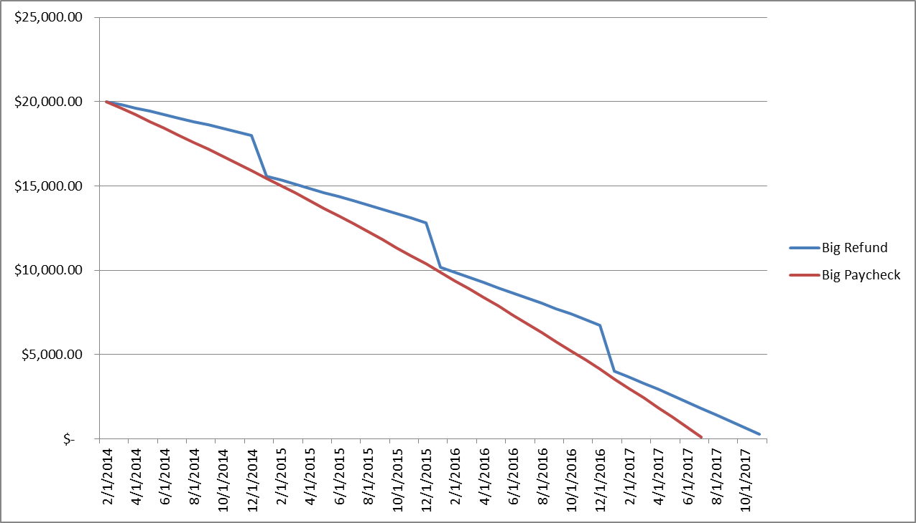
What is the Difference?
Notes:
12.5% on debt

Slide 15
Ideas On How To Get There
Everyone thinks differently so you have to find the ideas that work for you.
Find places to cut your expenses
What can you really live without?
Use Ting or third part cell phone service.
Latte Effect
5 days a week 50 weeks a year 5.00 = $1250
Pay off debt with that money as quickly as possible
How can we live more sacrificially?

Slide 16
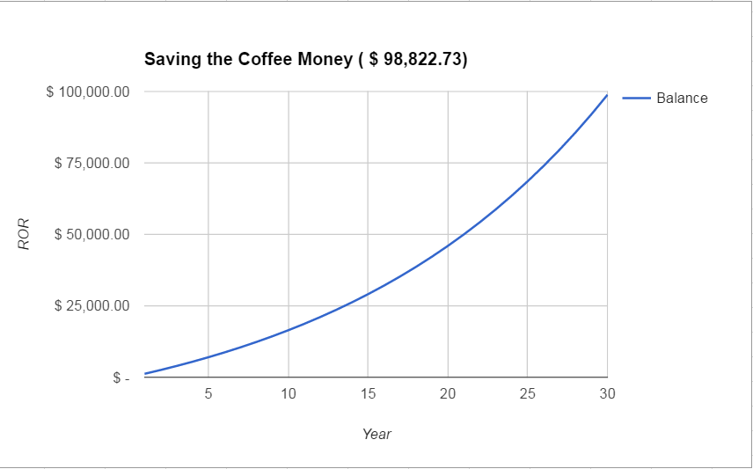
Latte Effect
What it looks like in 30 years invested at 6%

Slide 17
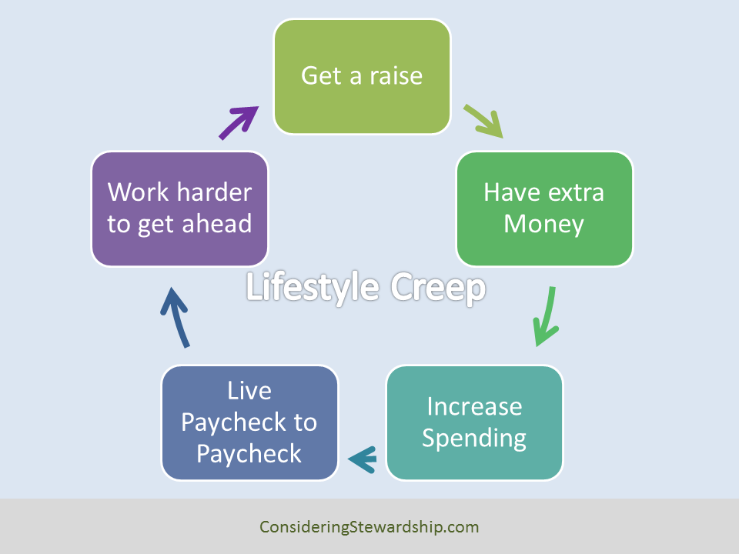
Watch Out for Lifestyle Creep
The tendency for our lifestyle to expand in proportion to our salary.

Slide 18
Investing for the Future
1 Tim 5:8 -- But if anyone does not provide for his relatives, and especially for members of his household, he has denied the faith and is worse than an unbeliever.
How can we balance giving sacrificially and planning for our retirement?

Slide 19
Investing for the Future
Where do we go from here.
Most of us would be better served paying off whatever debt we have instead of investing because you are probably paying more interest on your debt than you will make investing..
Exceptions:
Mortgage
Some Student Loans
401(k)

